Slide 1


Gold Miner
An MVC-Based Game
By Melody Li & Jingjing Pan

Slide 2
Agenda
Introduction
Motivation
Gameplay Elements
User Interface Enhancements
Testing
Findings and Future Work
By the end of our presentation, you will learn how to develope this interacting game with the tools learned from this class!

Slide 3

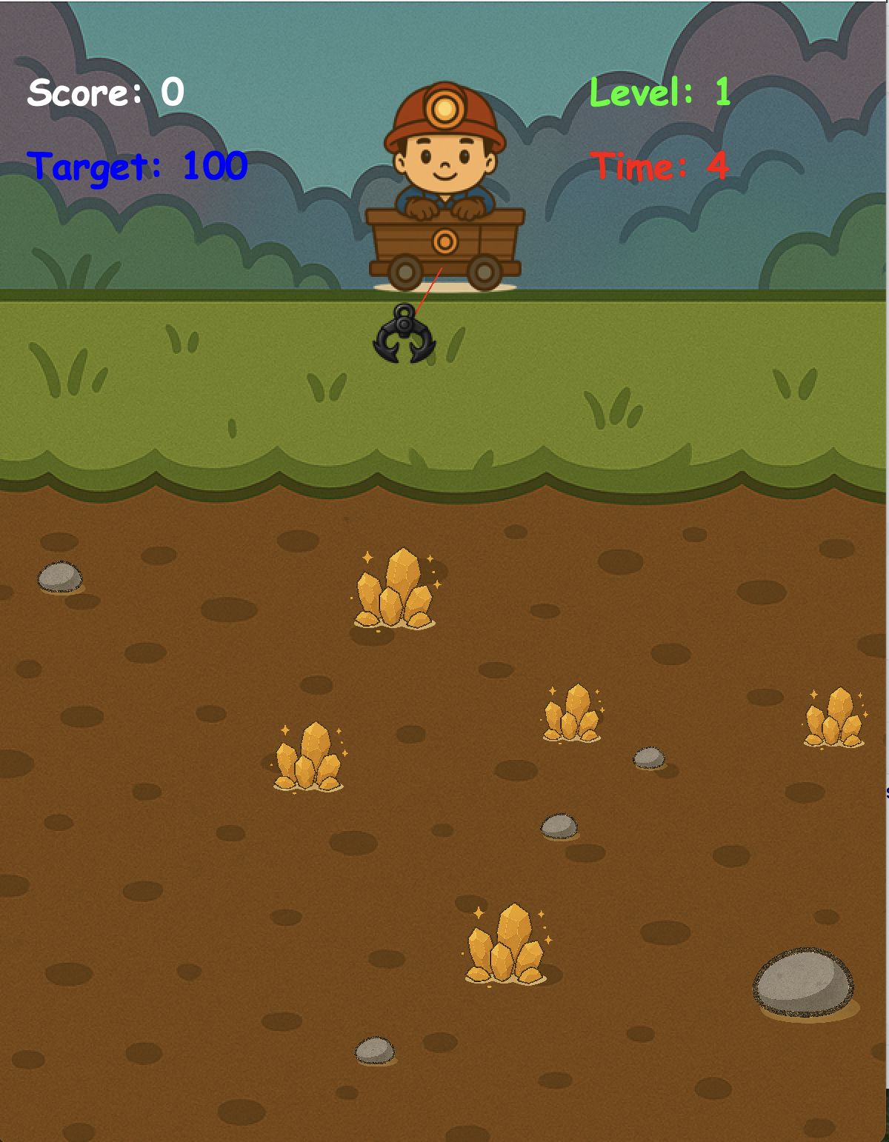
Introduction
A Gold Miner game where players use a swinging hook to grab various items.
Notes:
Let me take you on the journey to the world of gold miner! Imagine you are a miner inside this gold mine, which might also contain some stones… You will use a hook to collect as many items as you can with the highest value before time is up.

Slide 4
Motivation
Reinforce object-oriented design principles.
Implement a robust Model-View-Controller (MVC) architecture.
Enhance user interface
Drive the development with tests

Slide 5
MVC Structure
└── 📦 src
├── 📦 controller
│ └── GameController.java
│
├── 📦 model
│ ├── GameTimer.java
│ ├── Gold.java ← extends Item
│ ├── Item.java ← superclass for Gold, Stone
│ ├── Level.java
│ ├── Line.java
│ ├── Score.java
│ └── Stone.java ← extends Item
│
├── 📦 utils
│ └── ResourceLoader.java
│
└── 📦 view
├── BackgroundView.java
├── GameOverScreen.java
├── GamePanel.java
├── GameTimerView.java
├── GameWin.java
├── ItemView.java
├── LevelCompleteDialog.java
├── LevelView.java
├── LineView.java
├── ScoreView.java
├── StartScreen.java
└── ScreenListener (interface)
Model: Handles game data including items (Gold and Stone), score, timer, and game logic.
Polymorphism
View: Renders game elements (background, line with hook, items, score display, and custom dialogs).
Abstraction
Controller: Manages timing, collision detection, level progression, and game state updates.

Slide 6


Gameplay Elements
Swinging, extending, and retracting rope with a hook.
Multiple collectible items (Gold and Stone) generated without overlap
Dynamic scoring system based on item size.

Slide 7
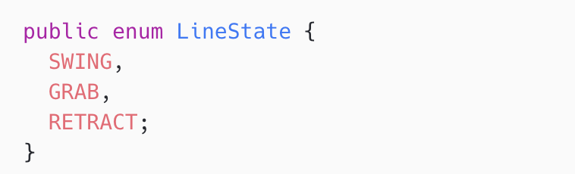
Gameplay Mechanics
The Hook and Rope:
A hook image is drawn at the tip of rope/line.
Line:
Line State: SWING, GRAB, RETRACT
Holds state (`LineState`), length, angle factor, and direction
Computes end‑point coordinates (`getEndX()`, `getEndY()`)

Slide 8
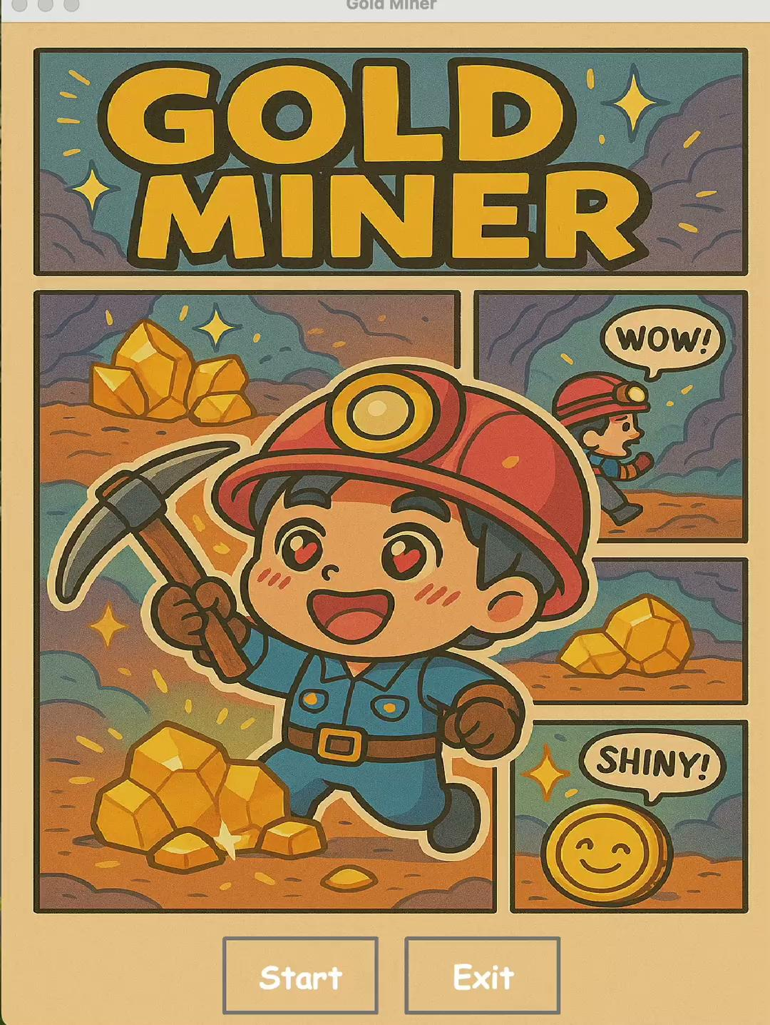
Swing / Grab / Retract Logic
1. SWING:
Angle factor oscillates between 0.1 and 0.9
Direction flips at min/max limits
2. GRAB:
Length increases until `MAX_LENGTH` reached
If hook collides with item, switch immediately to RETRACT
3. RETRACT:
Length decreases until `MIN_LENGTH` reached
If carrying an item, item’s `(x,y)` follows the hook position
On completion, item is marked collected and state returns to SWING

Slide 9
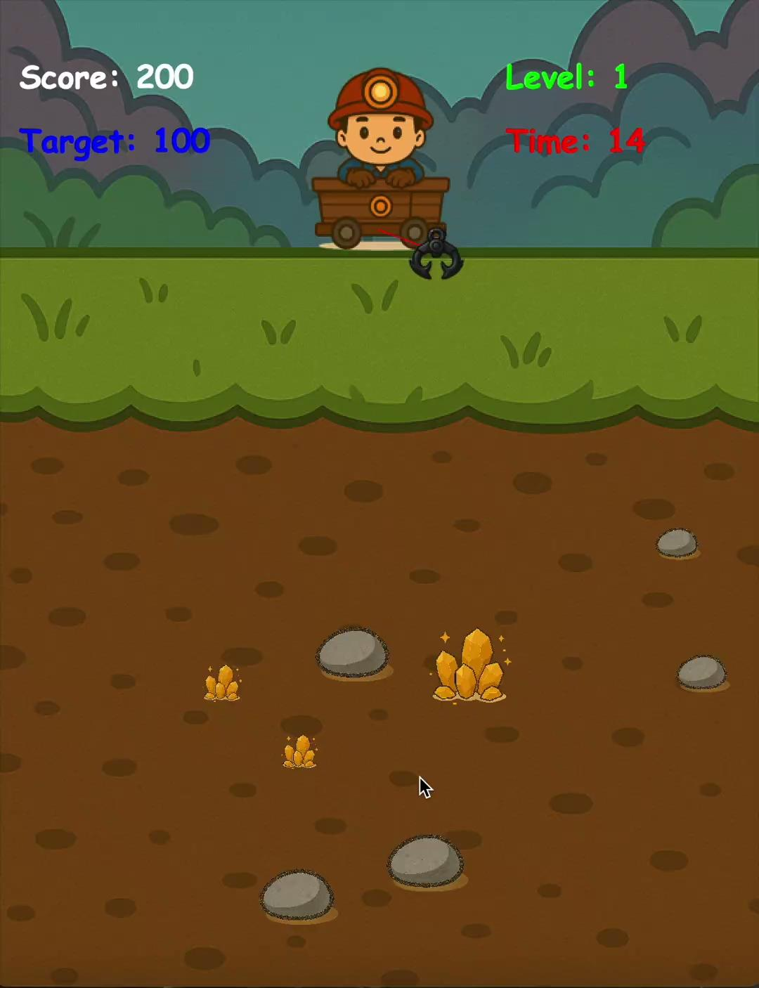
Gameplay Mechanics
2. Item Interaction:
When the hook collides with an item, that item is attached to the hook and retracted
Larger items affect retraction speed compared to smaller items
Different items affect retraction speed. For example, retracting golds is faster than retracting stones.

Slide 10
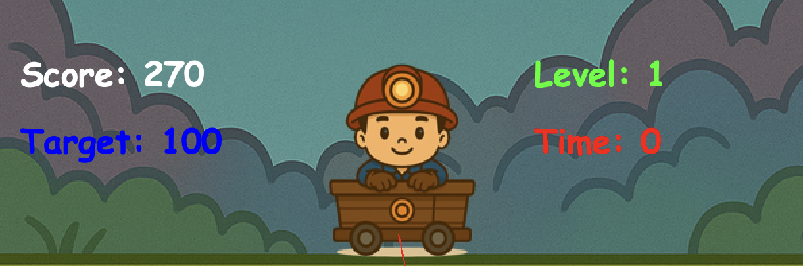
Gameplay Mechanics
3. Scoring and Levels:
Points are awarded according to item size
Target score must be reached within a time limit to progress

Slide 11
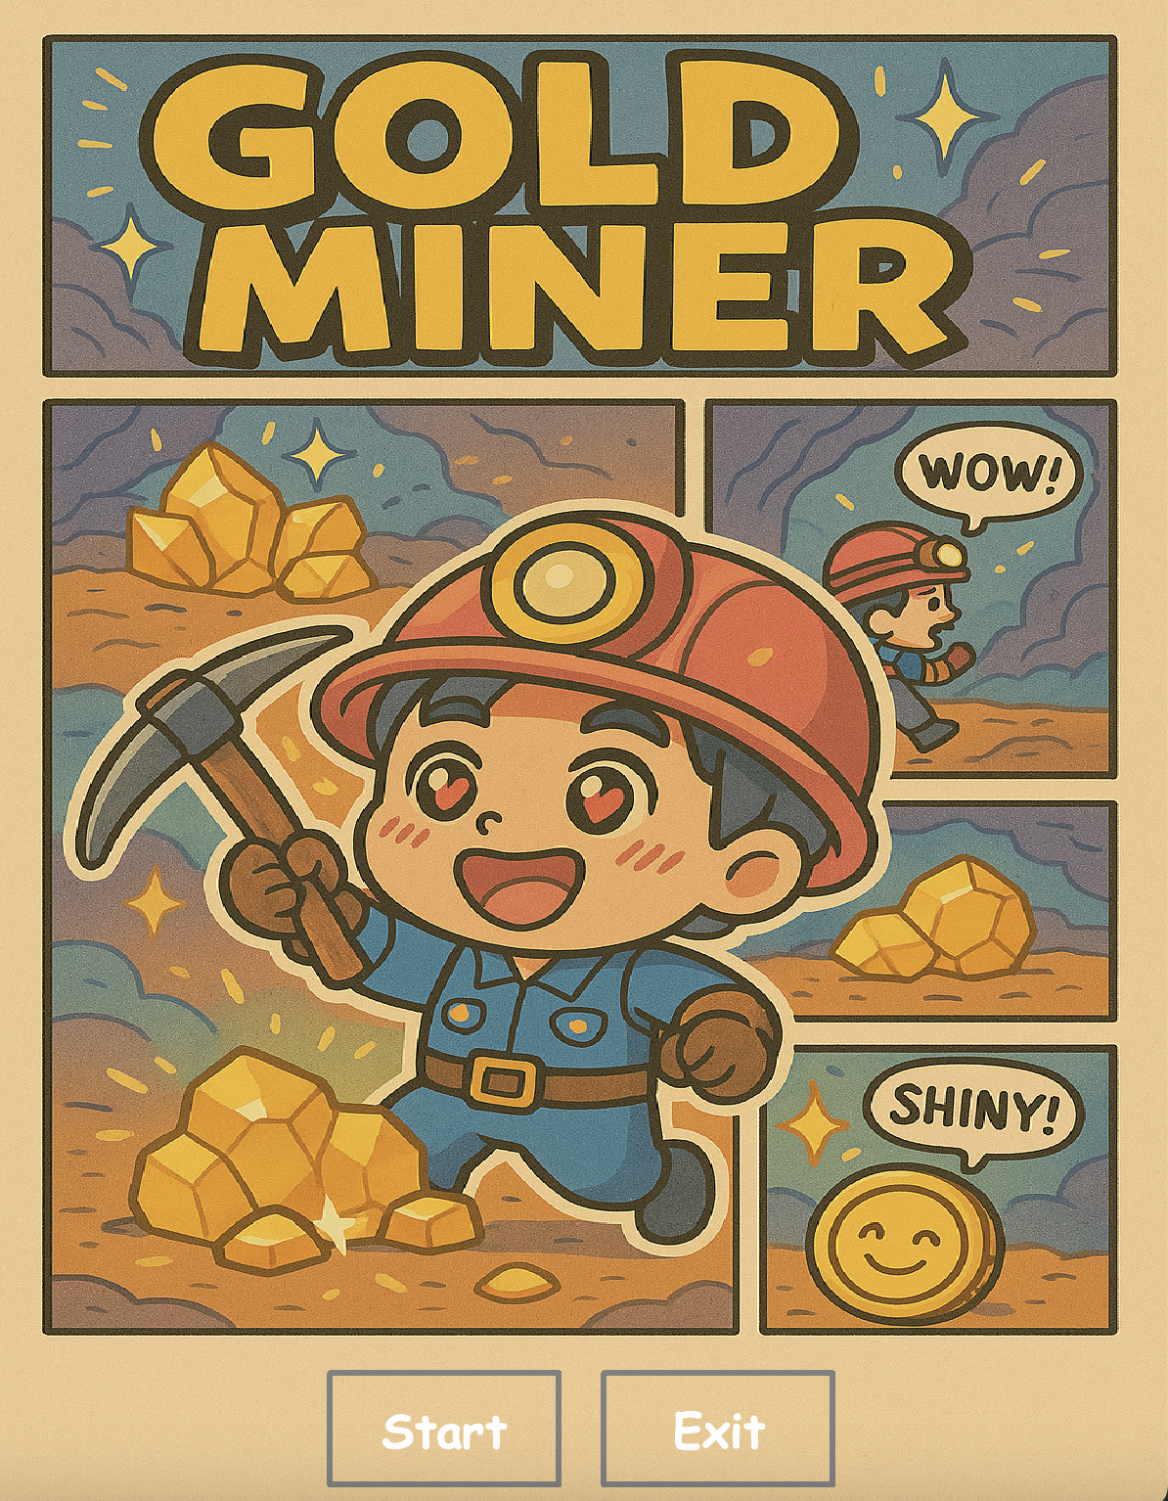
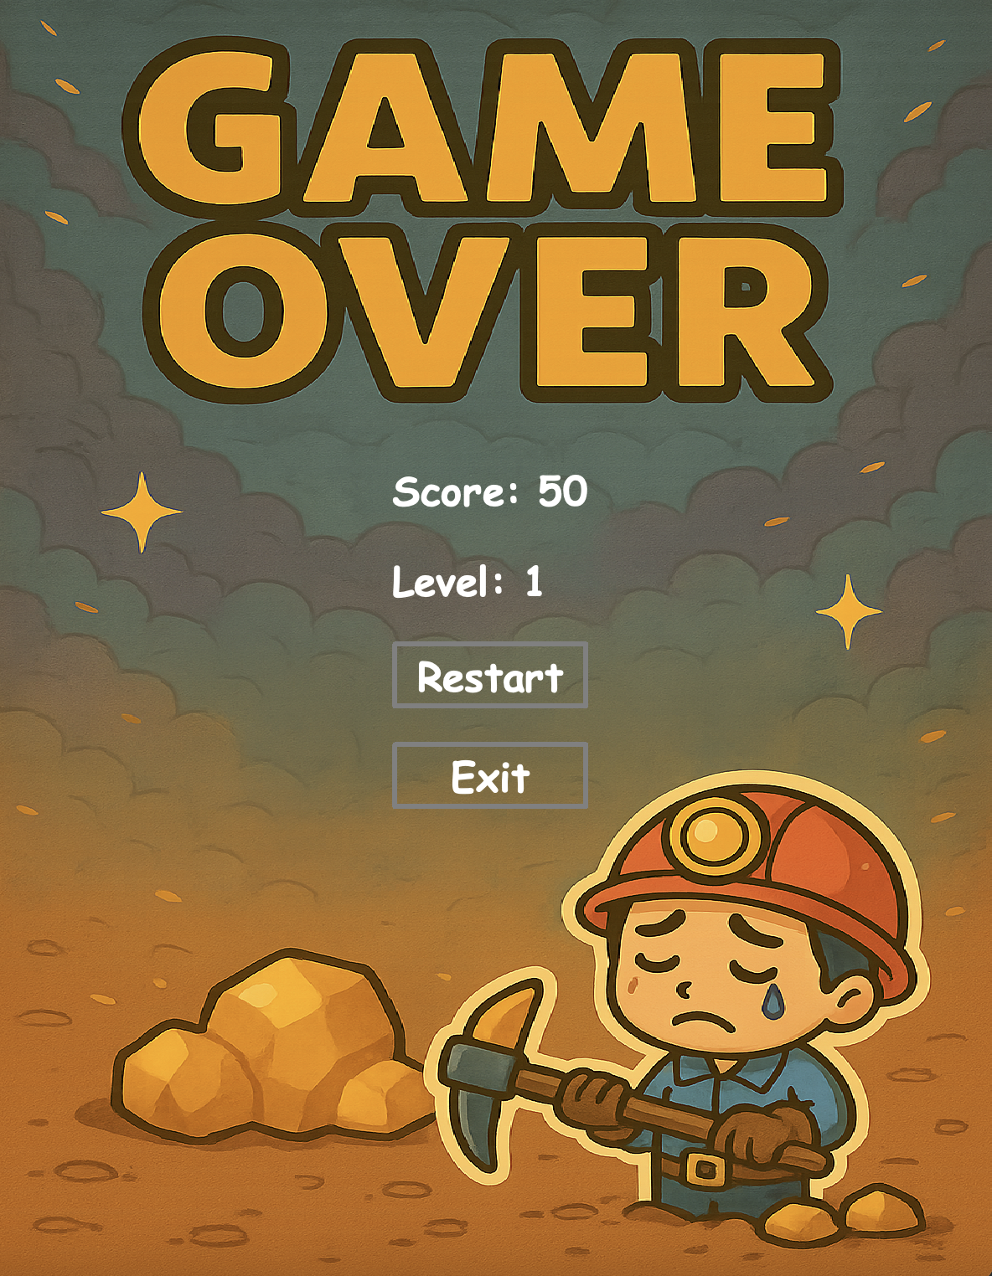
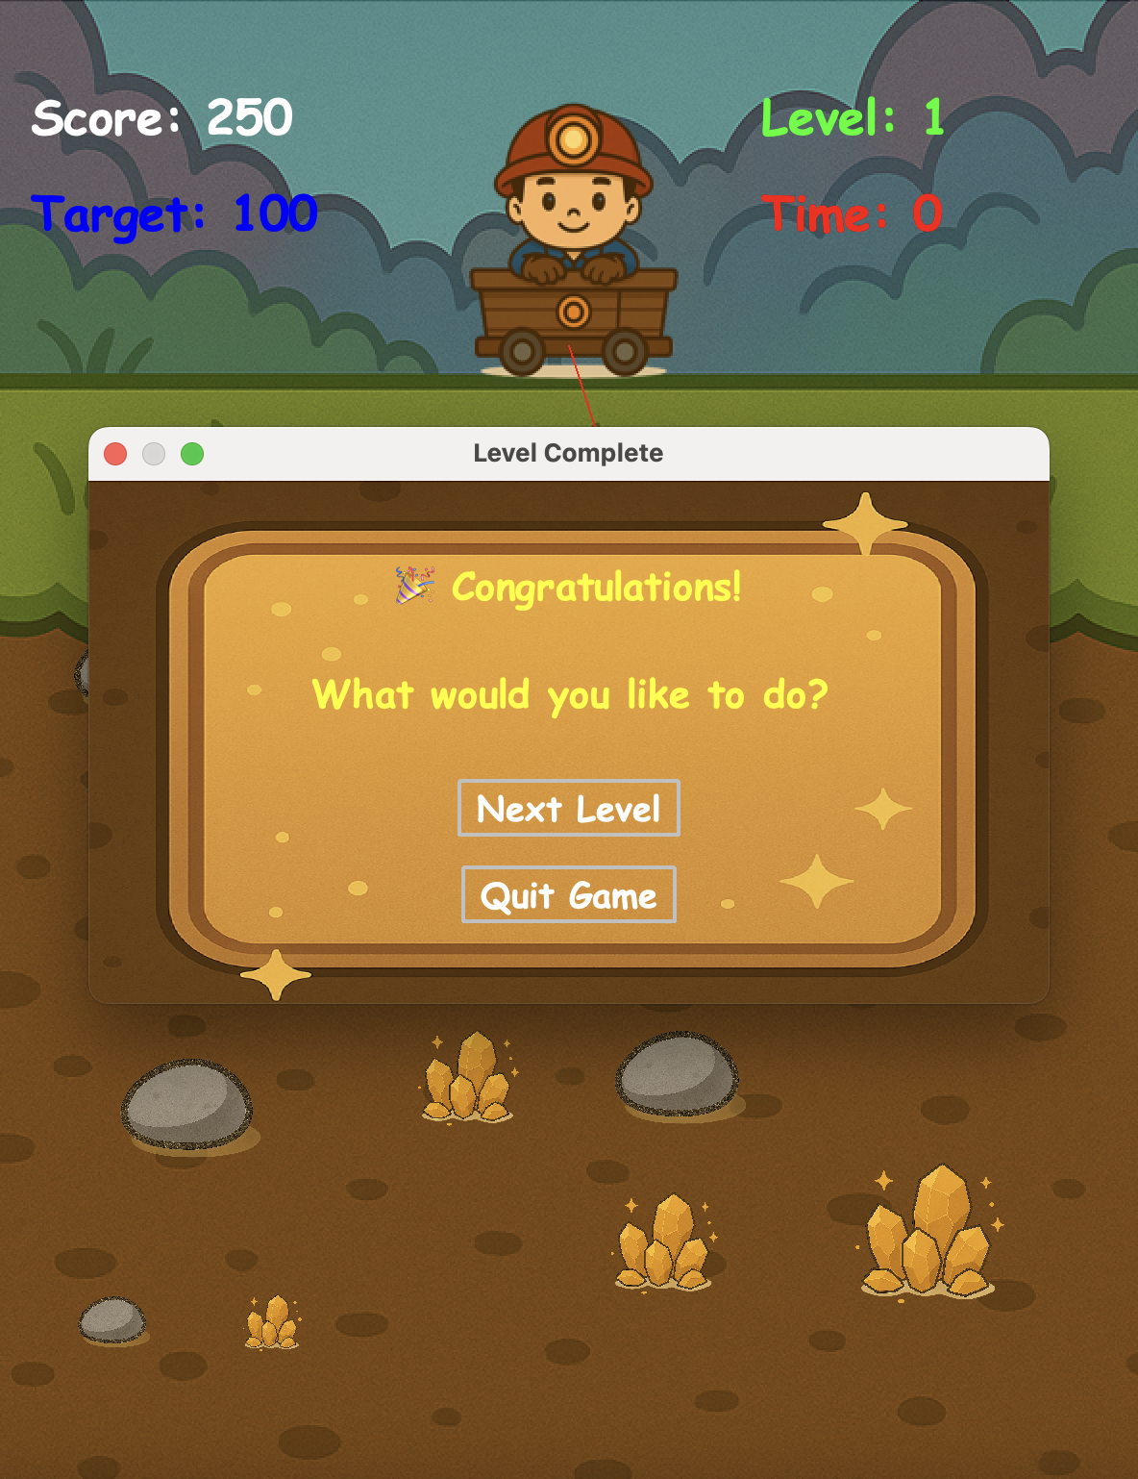
User Interface Enhancements
Custom, stylized start and game over screens.
A self-designed Level Complete dialog that prompts the user to proceed or exit.

Slide 12
Time, Score and Level Management
Countdown timer with custom display.
Level progression based on score and time conditions.

Slide 13
Why Testing Matters?
Early bug detection
Ensure correct scoring and line action logic
Validate collision and game progression
Confident code refactoring
Make the code maintainable
Ensure robust gameplay logic

Slide 14
Testing Methodologies
└── 📦 test
├── 📦 controller
│ └── GameControllerTest.java
│
├── 📦 model
│ ├── GameTimerTest.java
│ ├── GoldTest.java ← tests subclass behavior from Item
│ ├── ItemTest.java ← tests shared behavior
│ ├── LevelTest.java
│ ├── LineTest.java
│ ├── ScoreTest.java
│ └── StoneTest.java ← tests subclass behavior from Item
│
├── 📦 utils
│ └── ResourceLoaderTest.java
│
└── 📦 view
├── BackgroundViewTest.java
├── GameOverScreenTest.java
├── GamePanelTest.java
├── GameTimerViewTest.java
├── GameWinTest.java
├── ItemViewTest.java
├── LevelCompleteDialogTest.java
├── LevelViewTest.java
├── LineViewTest.java
├── ScoreViewTest.java
└── StartScreenTest.java
White-box testing
focus on internal logic
Example: score updates correctly
Black-box testing
focus on inputs/outputs
Example: start button
Mock objects via Mockito
isolate the class under test
control behavior of dependencies
when(...).thenReturn(true);
verify interactions
verify(mockStore).addPoint(anyInt());

Slide 15
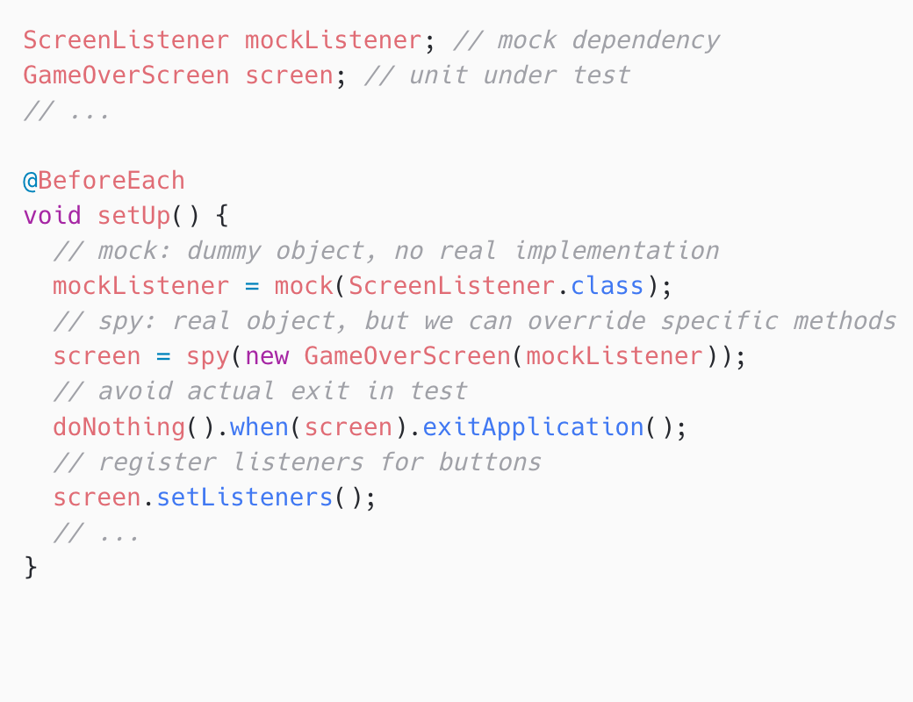
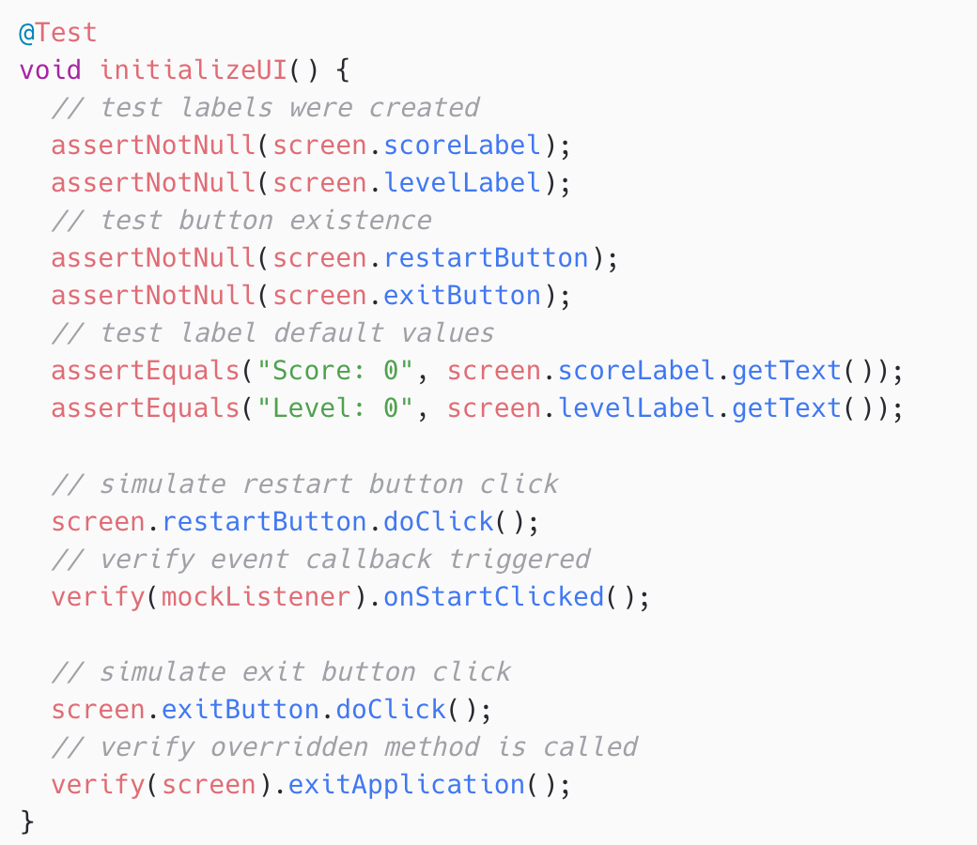
Code Walk-through

Slide 16
Findings and Reflection
Single responsibility principle: each class has a single well-defined responsibility
Using abstraction is essential in software development cycle and can reduce code duplication to a large extent
Using MVC architecture clearly separates concerns and improves testability
Use of mocking and spying to verify interactions and suppressing side effects
OOD principles make the development modular, maintainable and extensible

Slide 17
Limitations and Future Work
No audio elements added, such as when retracting a heavy stone or a small piece of gold, and when the line starts grabbing an item
No game history is recorded, such as the highest score for each level so far
User cannot retrieve game progress once paused
Dynamically add more items to make the game more engaging
Add more animations for the gold and miner
Extend the game to multiple players for more fun

Slide 18
Thank You!
Q&A

